Slide 1
Executive Functions Assessment
Presented by
George McCloskey, Ph.D.
Philadelphia College of Osteopathic Medicine
gmccloskz@aol.com or
georgemcc@pcom.edu

Slide 2
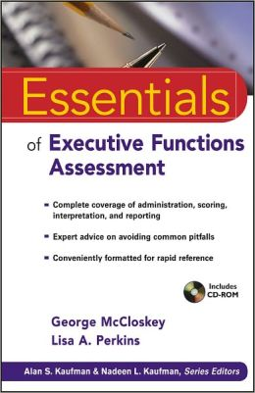

Slide 3
What are Executive Functions? Part 1
Executive Functions enable the brain to answer the questions of What? and When?

Slide 4
What are Executive Skills? Part 1
Executive Skills enable the brain to answer the question of How?

Slide 5
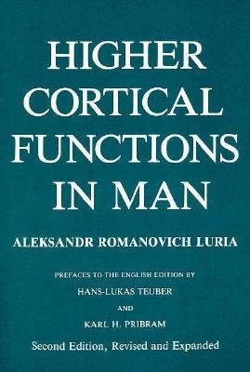
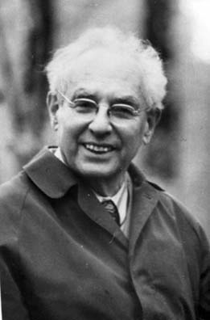

Slide 6
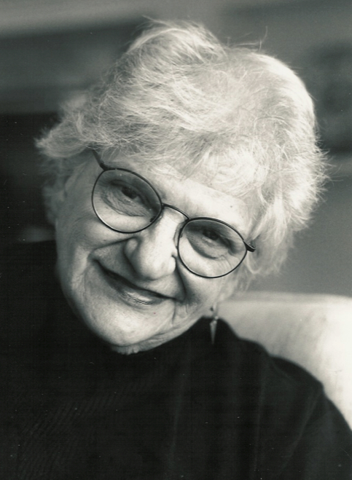
Kaplan, E. (1988). A process approach to neuropsychological assessment. In T. Boll & B.K. Bryant (Eds.) Clinical neuropsychology and brain functions: Research, measurement, and practice (pp. 125-167). American Psychological Association.

Slide 7
Key Concept
Assessment of the Use or Disuse of Executive Functions Hinges on Careful Observation of Behavior.

Slide 8
Executive Functions and Intelligence
The concept of executive functions is not synonymous with the traditional concepts of intelligence or “IQ”
Executive functions are not directly assessed with standard intelligence tests
= EF?

Slide 9
Executive Functions and Intelligence
Executive Functions and Skills are used to answer the questions: What? When? and How?
Standardized test directions provide the answers to the questions What? When? and How?
= EF?

Slide 10
Executive Functions and Intelligence
The use of standardized directions and the one-to-one format of test administration make it difficult to identify the extent that executive functions are or are not involved in task performance.
As a result of this, assessment of the use of executive functions during test performance hinges on careful observation of response behaviors.
= EF?

Slide 11
Interpretive Levels
The Process Approach requires a clear understanding of what a task measures so that performance can be effectively task analyzed to characterize a person’s cognitive capacities as accurately as possible.
Notes:
SI- changed scoring to 2,1,0 on initial items b/c got better discrimination between mild and mod disabilities

Slide 12
Behavior Observation and Inferences about Brain Function
What’s the difference between a Similarities Scaled Score of 12 (75th percentile) …
…and a Similarities Scaled Score of 12 (75th percentile)?

Slide 13
Subtest/Item Level Interpretation Process Approach Example
Retrieval of verbal information from long-term storage
vs
Reasoning with verbal information

Slide 14
Subtest/Item Level Interpretation Process Approach Example
Performance on Similarities also may or may not involve the engagement of one or more executive functions (e.g., gauge, flexible, shift, associate).

Slide 15
Questions about Intelligence
Do you believe it is possible to raise a child’s FSIQ from 70 to 100 through intervention?
Can it be done in 6 months? A year? Two years?

Slide 17
Ability Deficits
The conventional wisdom regarding ability deficits represents a fixed mindset.
What is needed is a new perspective that embraces a growth mindset.
A growth mindset suggests that abilities are not innate; they can be changed.

Slide 18
From Ability to Skill
The most critical shifts in educational thinking involve:
1) engendering a strong belief in the growth mindset that asserts that ability IS malleable.

Slide 19
From Ability to Skill
2) implementing and refining the techniques needed to change abilities into skills so that they are taught instead of merely measured.

Slide 20
From Ability to Skill
Marzano, Pickering & Pollock provided a blueprint for turning abilities into skills in their book “Classroom Instruction That Works: Research-based Strategies for Increasing Student Achievement.” (2001)

Slide 21
Marzano, Pickering & Pollock (2001)

Slide 22
2nd Edition
Dean, Hubbell, Pitler, & Stone (2012)

Slide 23
From Ability to Skill
Strategies discussed include:
Teaching Similarities and Differences
Teaching Hypothesis Testing
Teaching Vocabulary

Slide 24
From Ability to Skill
If these research-based strategies have been shown to work, why would it not be commonplace to expect to be able to increase “verbal ability” with good teaching practices?

Slide 25
Martin’s WISC Score Changes
11/2010
4/2013
9/2015
FSIQ | 70 | 99 | 103
GAI | 83 | 105 | 108
VCI | 73 | 95 | 106
PRI/FRI | 94 | 117 | 112
VSI | -- | -- | 111
WMI/AWMI | 62 | 97 | 94
PSI | 68 | 85 | 98

Slide 26
Martin’s Achievement Score Changes
11/2010
4/2013
9/2015
Wd Reading | 71 | 94 | 98
Wd Decoding | 81 | 97 | 98
Rdg Fluency | 66 | 95 | 100
Rdg Comp | -- | 87 | 82
Rdg Vocab | -- | 93 | 112

Slide 27
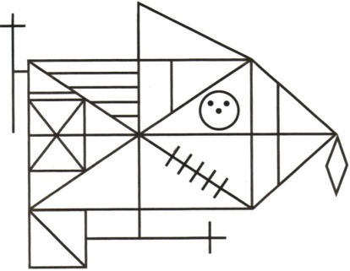
Martin Age 9, Rey Complex Figure Copy:
Self-initiated
Nov, 2010
Verbally Mediated
August, 2011

Slide 28
Subtest/Item Level Process Approach
Specific Behavior Observation Examples are provided in the Neuropsychological Approach to WISC-V Interpretation Chapter (McCloskey, et. al.) in Essentials of WISC-V Assessment.

Slide 29
Subtest/Item Level Process Approach Example
What Does Block Design Measure?
Consider the following quote from John Carroll (Human Cognitive Abilities, 1993, page 309) :

Slide 31
Subtest/Item Level Process Approach Example
What Does WISC/WAIS Block Design Measure?
“…difficulty in factorial classification arises from the fact that most spatial test tasks, even the “simplest,” are actually quite complex, requiring apprehension and encoding of spatial forms, consideration and possibly mental manipulations of these forms, decisions about comparisons of other aspects of the stimuli, and making a response – often under the pressure of being required to respond quickly.”

Slide 32
What Does Block Design Measure?
From Carroll’s description, Block Design can be measuring at least 5 distinct cognitive processes:
Visual perception and discrimination
Reasoning with visual stimuli
Visualization (optional)
Motor dexterity
Speed of motor response

Slide 33
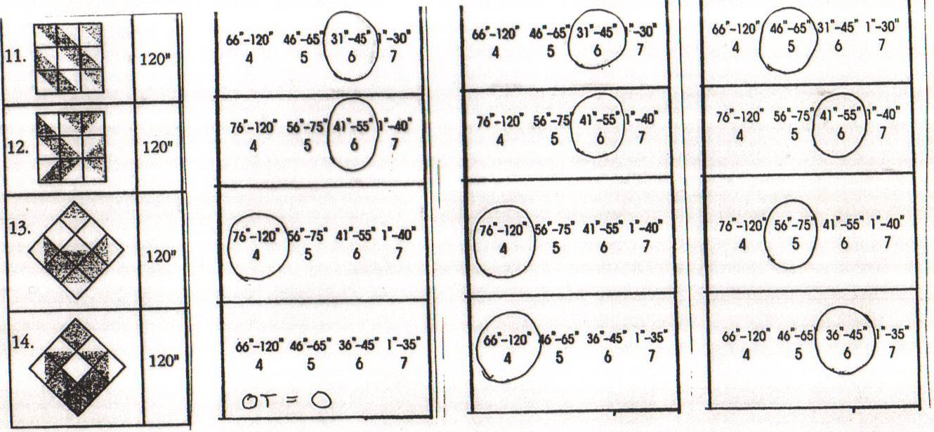
Measuring Problem-Solving or Executive Functions with a Block Design Task
Who will have the best Block Design score?
16 20 22

Slide 34
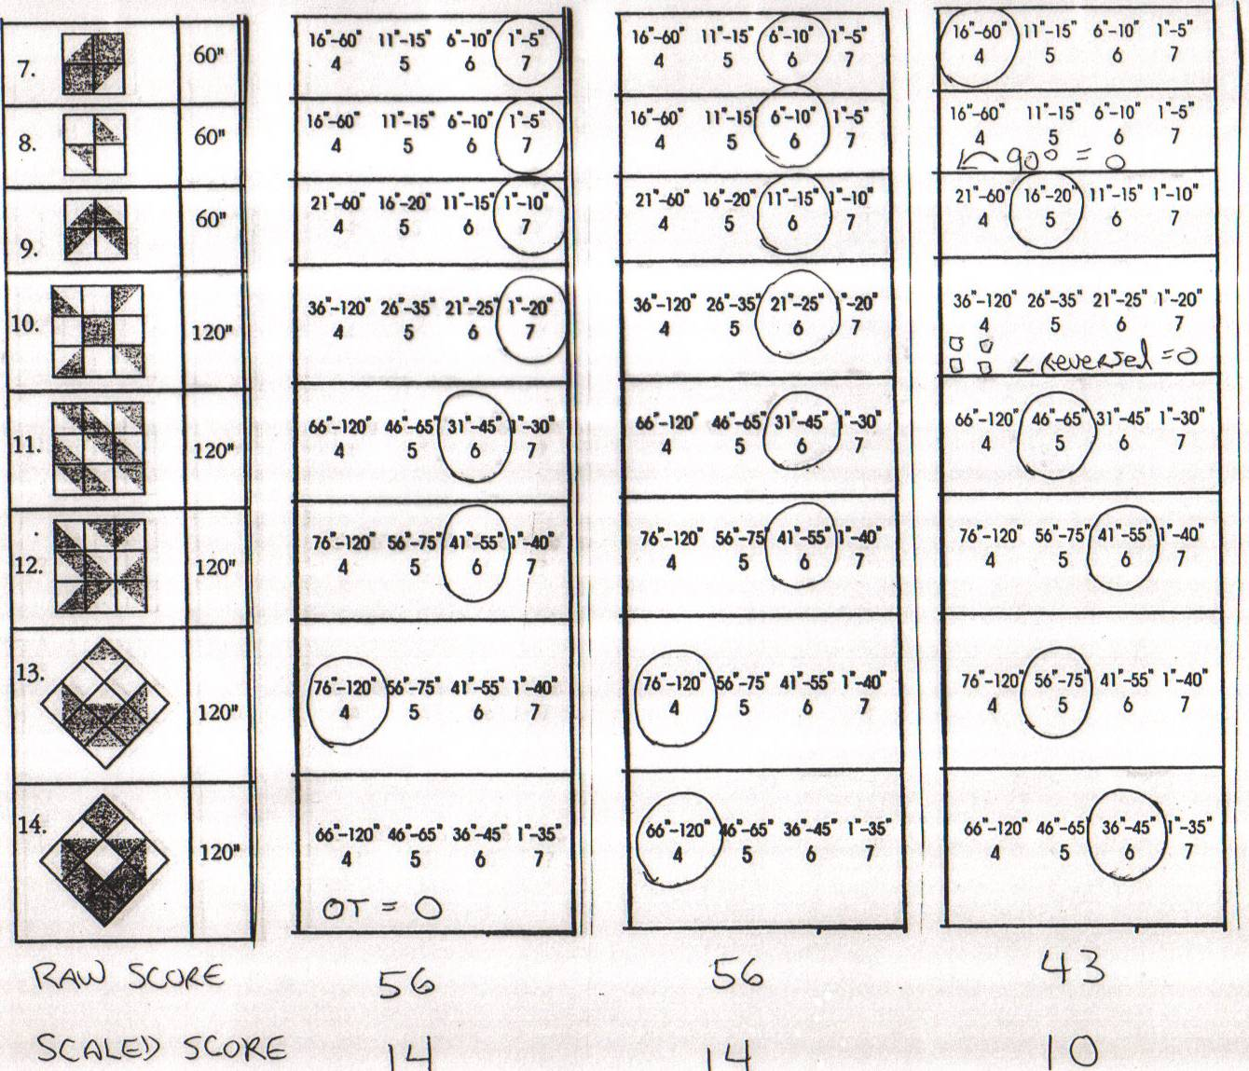
What Does Block Design Measure?
56 56 43
14 14 10
Raw Score
Scaled Score

Slide 35
What Does Block Design Measure?
From Carroll’s description of Block Design, which of the 5 distinct cognitive processes do you think Subject 3 lacked?
Visual perception and discrimination
Reasoning with visual stimuli
Visualization (optional)
Motor dexterity
Speed of motor response

Slide 36
The Process Approach to Analysis of Block Design
Consider the following quote from Carroll (1993, p. 309):
…considerable confusion exists about the identification of factors in the domain of visual perception… Some sources of confusion are very real, and difficult to deal with. This is particularly true of confusion arising from the fact that test takers apparently can arrive at answers and solutions – either correct or incorrect ones – by a variety of different strategies. French (1965) demonstrated that different “cognitive styles” can cause wide variation in factor loadings; some of his most dramatic cases had to do with spatial tests, as where a sample of subjects who reported “systematizing” their approach to the Cubes test yielded a large decrease of the loading of this test on a Visualization factor (that is, decreased correlations of Cubes with other spatial tests), as compared to a sample where subjects did not report systematizing. It has been shown (Kyllonen, Lohman, & Woltz, 1984), that subjects can employ different strategies even for different items within the same test. Lohman et al. (1987) have discussed this problem of solution strategies, even rendering the judgment that factor-analytic methodology is hardly up to the task of dealing with it because a basic assumption of factor analysis is that factorial equations are consistent over subjects.

Slide 37
What Does Block Design Measure?
Carroll’s description leaves out a critical 6th cognitive process, or group of processes, essential for effective performance of Block Design – the ability to initiate, focus, sustain, coordinate/balance, and monitor the use of the other cognitive processes – i.e., Executive Function processes.

Slide 38
What Does Block Design Measure?
An appropriate statement regarding the performance of the third subject would be:
“John’s superior capacity for problem-solving with nonverbal visual material was applied inconsistently resulting in a Block Design Subtest Score in the average range.”

Slide 39
Executive Functions and Intelligence
The concept of executive functions is not synonymous with the traditional concepts of intelligence or “IQ”
Executive functions are not directly assessed with standard intelligence tests
= EF?

Slide 40
Measuring Executive Functions with a Reasoning Task
Directions for the Wisconsin Card Sorting Test (WCST):
I can’t tell you much about how to do this task. Which of these do you think this one goes with? I’ll tell you if your answer is right or wrong.
= EF?

Slide 41
Executive Functions and School
The more classroom instruction resembles tests of executive functions like the Wisconsin Card Sorting Test (figure out what we’re learning, I’ll tell you whether you are right or wrong), the more executive difficulties are going to impact classroom learning and performance.
= EF?

Slide 42
Key Concept
Task Performance is directed by Executive Functions or an
Executive Functions substitute.
The neural networks used to
perform a task depend on perceptions about how the task should be done.

Slide 43
Key Concept
Most of what a teacher, therapist, or work supervisor says to student, client, or worker is intended to activate specific neural networks within that person’s brain.

Slide 44
Key Concept
The more specific the language used by a teacher, therapist or supervisor the more likely it is that the student, client or worker will be activating the brain networks needed for effective performance.

Slide 45
Key Concept
Effective use of Executive Functions can vary by Arena of Involvement as well as by Domain of Functioning.

Slide 46
Arenas of Involvement
Intrapersonal
Control of Self in
Relation to Self
Interpersonal
Control of Self in
Relation to Others
Environment
Control of Self in
Relation to Surroundings
Symbol System
Control of Self in Relation to Academics (Reading, Writing, Math)

Slide 47
Key Concept
Effective EF assessment is multidimensional in nature and addresses the use of Efs within all four domains of functioning and across all four arenas of involvement.

Slide 48
Key Concept
Executive Function Deficits
When thinking about how to assess executive functions, it is helpful to think about best practices in assessing for ADHD (and beyond).
ADHD

Slide 49
The Multidimensional Nature of Executive Functions
Use of Executive Functions varies depending on:
the arena(s) of involvement in which the EF(s) are operating,
the domain(s) being directed by the EF(s)

Slide 50
The Multidimensional Nature of EF Assessment
The Multidimensional Nature of the use of Executive Functions necessitates a Multidimensional approach to their assessment.
Assessment of Executive Functions needs to address the use of Efs within all four domains of functioning and across all four arenas of involvement

Slide 51
EF Assessment Perspective x Method
Assessment Perspective | Assessment Method
 | Formal Methods – Using interviews, records reviews, and observation and interpretation methods that make use of standards established through normative comparisons | Informal Methods – Using interviews, records reviews, and observation and interpretation methods that do not make use of standards established through normative comparisons
Indirect Perspective – Collecting information in a manner that does not require direct contact with, or observation of, the client | Behavior Rating Scales Parent & Teacher Behavior Rating Scales Self-Report Rating Scales (e.g., BRIEF or MEFS Parent, Teacher and Self Rating forms) | Interviews of Parents, Teachers (e.g., use of the EFSO) Review of School Records Process-oriented Interpretation of Parent and Teacher Ratings and Self Reports
Direct Perspective – Collecting information through direct interactions with, or through direct observations of, the client | Individually-Administered Standardized Tests (e.g., D-KEFS, NEPSY-II, WCST, BADS, BADS-C) Cross-battery Cascading Production Decrement/Increment Analysis | Child Interview Systematic and Nonsystematic Behavioral Observations (e.g., use of the EFSO and EFCO) Process-oriented Interpretation of Standardized Test Performance and Classroom Work Samples

Slide 52
EF Assessment
Indirect Informal:
Interviews
Records Reviews
Process-oriented analysis of rating scale items

Slide 53
EF Assessment
Indirect Formal:
Rating Scales
Parent
Teacher
Self
Adult Informant

Slide 54
EF Assessment
Direct Formal:
Standardized Norm-referenced Tests
D-KEFS, WCST, NEPSY-II
Cross-battery Cascading Production Decrement /Increment Analyses

Slide 55
EF Assessment
Direct Informal:
Process-oriented interpretation of assessment performance
Child Interview
Behavior Observations

Slide 56
Key Concept
Effective EF assessment is multidimensional in nature and ideally addresses the use of EFs within all four domains of functioning and across all four arenas of involvement.

Slide 57
EF Assessment Matrix
 | Perception | Emotion | Cognition | Action
Self
Others
Environ- ment
Symbol Systems

Slide 58
EF Assessment
Indirect Informal:
Interviews
Records Reviews
Process-oriented analysis of rating scale items

Slide 59
Key Concept
The most effective approach to EF assessment involves
clinical interview(s)
followed by additional data collection methods to test hypotheses generated from the interview(s)

Slide 60
The Multidimensional Nature of EF Assessment
Conducting a thorough clinical interview:
Identify arenas of involvement that are of concern, within the arenas of concern:
Identify domains of functioning that are of concern
Identify the specific executive function level(s) that are of concern
Identify the specific executive functions and/or executive skills that are of concern

Slide 61
EF Assessment
Indirect Informal:
Interviews
Records Reviews
Process-oriented analysis of rating scale items

Slide 62
The Multidimensional Nature of EF Assessment
Conducting a thorough records review:
Identify previously assigned diagnoses or classifications indicative of EF capacity difficulties (most DSM-V diagnoses apply)
Identify anecdotal reports of behavior indicative of executive capacity difficulties
Identify previous test results indicative of executive capacity difficulties

Slide 63
Records Review
Minimal records were available for review prior to the evaluation. These included a teacher referral form, a parent input form, and Alan’s Speech/language IEPs. A summary of relevant statements from the teacher referral form and the likely executive functions difficulties reflected in these statements include:
Difficulties getting along with classmates (Flexible, Awareness of Others)
Demanding with peers (Flexible)
Only wants to do things his way (Flexible)
Expresses frustration in hurtful ways (Modulate, Monitor, Correct)
Becomes obsessed with making sure work is accurate (Modulate, Balance)
Frustrated with class rules (Modulate, Flexible)
Difficulty recovering emotionally from disagreements (Modulate, Flexible)

Slide 64
A summary of relevant statements from the parent input form and the likely executive functions difficulties reflected in these statements include:
Becomes easily frustrated with his peers (Modulate, Awareness of Others)
Thinks he knows best (Flexible)
Does not listen to what others have to say (Perceive, Flexible, Awareness of Others)
Easily frustrated when things do not go according to schedule (Modulate, Flexible)
Reacts negatively to corrective feedback (Modulate, Flexible)
Gives up with written homework assignments (Sustain)
Seems unable to relax as needed (Modulate, Balance)

Slide 65
Assessing Efs
Using
Rating Scales

Slide 66
EF Assessment
Indirect Formal:
Rating Scales
Parent
Teacher
Self
Adult Informant

Slide 67
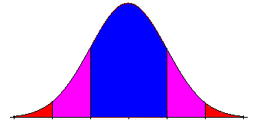
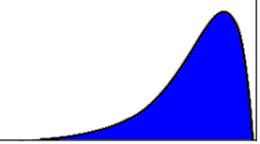
EF Assessment
Norm-referenced rating scales provide standardized scores, but it is important to keep in mind that the scores that are provided usually are normalized T-scores; the ratings do not distribute normally but rather are negatively skewed.

Slide 68
Indirect Formal Assessment of EFs
Ideally, a rating scale designed to assess EFs would identify specific strengths and weaknesses within EF Levels (Self-Regulation, Self-Realization, Self-Determination, Self-Generation), Domains of Functioning (Perception, Emotion, Thought, Action), and Arenas of Involvement (Intrapersonal, Interpersonal, Environment, Symbol System).

Slide 69
BRIEF Parent, Teacher, Self-Report Forms
Behavior Rating Inventory of Executive Functions (BRIEF, 1996; BRIEF 2, 2015)
Parent, and Teacher and Self-Report Forms (BRIEF 2, 2015)
Preschool and Adult forms
Norm-referenced scores

Slide 70
Parent, Teacher, Self-Report Inventories
Recently, 4 additional EF Rating Scales have been published:
D-REFS (Delis Rating of Executive Function; 2012)
BDEFS-CA (Barkley Deficits in Executive Functioning Scale; 2012)
CEFI (Comprehensive Executive Functions Inventory; 2013)
MEFS (McCloskey Executive Functions Scales; 2016)

Slide 71
Interpretive Levels Framework
Global Composite
(E.g. GEC)
Specific Composites/
Clinical Clusters Level
Subtest Level
Item Ratings Level
Cognitive Constructs
Level
(What does this item really assess?)

Slide 72
Parent, Teacher, Self-Report Inventories
The BRIEF assesses self-regulation EFs under the following 8 headings:
Inhibit, Shift, Emotional Control, Initiate, Working Memory, Plan/Organize, Org. of Materials, Monitor

Slide 73
Parent, Teacher, Self-Report Inventories
 | T-Scores and (Percentile Ranks)
Scales | Mother | Father | Math Teacher | Social Studies Teacher | Language Arts Teacher | Learning Support Teacher
Inhibit | 49 (65) | 47 (55) | 53 (75) | 49 (65) | 77 (96) | 85 (98)
Shift | 38 (14) | 42 (28) | 53 (78) | 45 (50) | 65 (92) | 57 (85)
Emotional Control | 37 ( 8) | 39 (17) | 50 (65) | 46 (50) | 54 (80) | 46 (50)
Initiate | 56 (80) | 53 (71) | 69 (95) | 85(>99) | 96(>99) | 81(>99)
Working Memory | 60 (84) | 62 (88) | 85(>99) | 92(>99) | 92(>99) | 106(>99)
Planning/ Organize | 62 (86) | 60 (83) | 73 (95) | 80 (98) | 80 (98) | 92 (>99)
Organize Materials | 49 (52) | 43 (33) | 57 (88) | 46 (60) | 69 (95) | 111(>99)
Monitor | 46 (42) | 40 (20) | 63 (90) | 66 (93) | 80 (98) | 77 (97)

Slide 74
EF Assessment
Indirect Informal:
Interviews
Records Reviews
Process-oriented analysis of rating scale scores and items

Slide 75
Parent, Teacher, Self-Report Inventories
BRIEF Interpretive Cautions:
Identical BRIEF Scale T-scores can result from very different response patterns.
Critical EF difficulties may be masked by low T-scores based on aggregation of multiple items.

Slide 76
Parent, Teacher, Self-Report Inventories
BRIEF Interpretive Cautions:
An elevated T-score can result from a rating of “Sometimes” for all, or nearly all, items on a Scale, or from a rating of “Often” for a smaller subset of items on a Scale.

Slide 77
Parent, Teacher, Self-Report Inventories
BRIEF Interpretive Cautions:
Because each BRIEF Scale is an amalgam of multiple EFs, certain areas of deficit may not be reflected in the Scale T-score.

Slide 78
Parent, Teacher, Self-Report Inventories
BRIEF Interpretive Cautions:
Example: The BRIEF Inhibit Scale combines items assessing Inhibit, Modulate, and Stop. If a client only exhibits Modulate problems, the T-score may not be clinically elevated. The low T-score will be masking the Modulate difficulties.

Slide 79
BRIEF 2 Inhibit Scale Parent and Teacher Form Items
 |  |  | Executive Functions
INHIBIT SCALE |  |  | Likely to be Associated with Behaviors
Item Description | P | T | PRIMARY EF | SECONDARY Efs
FIDGETY | X | X | MODULATE | MONITOR
OUT OF SEAT WRONG TIME | X | X | INHIBIT | MONITOR
OUT OF CONTROL | X | X | MODULATE | MONITOR
TOO WILD | X | X | MODULATE | MONITOR
Trouble STOPPING | X | X | STOP | MODULATE | MONITOR
TOO SILLY | X |  | MODULATE | MONITOR
Talks at WRONG TIME | X | X | INHIBIT | MONITOR
NO THOUGHT BEFORE ACT |  | X | ANTICIPATE | INHIBIT
IMPULSIVE ACTIONS | X | X | INHIBIT | MONITOR

Slide 80
BRIEF INITIATE SCALE
 |  |  | Executive Functions
 |  |  | Likely to be Associated with Behaviors
Item Descriptions | P | T | PRIMARY EF | SECONDARY Efs
NOT A SELF STARTER | x | x | INITIATE | GENERATE | ENERGIZE
MUST BE TOLD TO BEGIN | x | x | INITIATE | ENERGIZE
TROUBLE THINKING OF THINGS TO DO | x |  | GENERATE
TROUBLE GETTING STARTED | x | x | INITIATE | ENERGIZE
TROUBLE ORGANIZING Activities | x |  | ORGANIZE | DECIDE
DOESN'T TAKE INITIATIVE | x | x | INITIATE | GENERATE | ENERGIZE
Complains NOTHING TO DO | x |  | GENERATE
LIES AROUND | x |  | INITIATE | ENERGIZE
DOESN'T SHOW CREATIVITY |  | x | GENERATE
Trouble finding NEW WAYS TO SOLVE PROBLEMS |  | x | GENERATE
Trouble finding NEW WAYS TO SOLVE PROBLEMS |  | x | GENERATE

Slide 81
BRIEF PLAN/ORGANIZE SCALE
 |  |  | Executive Functions
 |  |  | Likely to be Associated with Behaviors
Item Description | P | T | PRIMARY EF | SECONDARY Efs
DOESN'T REMEMBER to br | x | x | RETRIEVE | MONITOR
CAN'T GET IDEAS ONTO PA | x | x | MANIPULATE | HOLD | EXECUTE
DOESN’T ASSOCIATE home | x |  | ANTICIPATE | ASSOCIATE
DOESN'T REMEMBER to ha | x | x | MONITOR | RETRIEVE | ANTICIPATE
MISSES BIG PICTURE - OVE | x | x | BALANCE
DOESN'T GET JOB DONE | x | x | SUSTAIN | ENERGIZE
OVERWHELMED by large | x | x | MODULATE | ORGANIZE | FOCUS/SEL
UNDERESTIMATES TIME fo | x | x | ESTTIME | GAUGE
STARTS tasks AT LAST MIN | x | x | ESTTIME | GAUGE | SENSE T |  | INITI
DOESN'T PLAN AHEAD | x | x | PLAN | ANTICIPATE
POORLY ORGANIZED writ | x | x | ORGANIZE | SEQUENCE
DOESN'T COMPLETE ACT | x |  | SUSTAIN | ENERGIZE

Slide 82
Parent, Teacher, Self-Report Inventories
Ideally, behavior rating inventories would offer coverage of a broad array of executive functions across all 4 domains within all 4 arenas of involvement.

Slide 83
Advances in the
Assessment of Efs
Using
Rating Scales

Slide 84
Parent, Teacher, Self-Report Inventories
The McCloskey Executive Function Scales (MEFS) assess 33 self-regulation executive functions across multiple domains of function within multiple arenas of involvement:
School (Symbol System)
Social (Interpersonal)
Self (Intrapersonal)

Slide 85
MEFS Parent, Teacher, Self-Report Forms
Raters make judgments about level of competency as well as frequency:
Frequency of EF Strength (EFS)
Frequency of Executive Function Deficit (EFD)
Frequency of Executive Skill Deficit (ESD)

Slide 86
MEFS Parent, Teacher, Self-Report Forms
Attention Cluster
BECOMING AWARE
Knows what he or she should be doing for school tasks and knows when to do it.
Makes eye contact with, listens to, and touches others in an appropriate way in social situations.
FOCUSING ATTENTION
Focuses attention on school tasks.
Focuses attention on others in social situations.
SUSTAINING ATTENTION
Sustains attention for school tasks until a task is completed.
Sustains attention to others in social situations.

Slide 87
MEFS Parent, Teacher, Self-Report Forms
5 | AA | Always or almost always does this on his or her own. Does not need to be prompted or reminded (cued) to do it.
4 | F | Frequently does this on own without prompting
3 | S | Seldom does this on own without being prompted, reminded, or cued to do so.
2 | AP | Does this only after being prompted, reminded, or cued to do it.
1 | DA | Only does it with direct assistance. Requires much more than a simple prompt or cue to be able to get it done in situations that require it.
0 | UA | Unable to do this, even when direct assistance is provided.

Slide 88
MEFS Teacher Inventory
EF Deficit Percentages within the Attention Cluster
Attention | NONE | S/L | LD | ADHD -M | ADHD -N | ASD | ED
Cluster | n=813 | n=34 | n=48 | n=47 | n=56 | n=38 | n=21
SREF | % | % | % | % | % | % | %
Percieve -A | 17 | 27 | 54 | 38 | 71 | 71 | 67
Percieve -S | 14 | 24 | 35 | 36 | 43 | 79 | 62
Focus -A | 25 | 27 | 65 | 68 | 71 | 78 | 71
Focus -S | 13 | 15 | 33 | 45 | 34 | 82 | 57
Sustain -A | 28 | 32 | 65 | 79 | 84 | 76 | 76
Sustain -S | 14 | 21 | 35 | 49 | 48 | 87 | 62

Slide 89
EF Assessment
Direct Formal:
Standardized Norm-referenced Tests
D-KEFS, WCST, NEPSY-II
Cross-battery Cascading Production Decrement Analyses of N-R Tests

Slide 90
Assessment of Executive Functions
Norm-referenced assessments of executive functions are currently available, including:
Individually-administered tests
Behavior rating scales

Slide 91
Assessment of Executive Functions
The limitations of the current methods available need to be understood and taken into account when conducting an assessment.

Slide 92
Key Concept
Standardized, individually-administered measures of executive functions only assess the use of executive functions within the Symbol System Arena.

Slide 93
EF Assessment Using Individually Administered Tests
 | Perception | Emotion | Cognition | Action
Self
Others
Environ- ment
Symbol Systems | X |  | X | X

Slide 94
Key Concept
Although limited in scope, individually-administered assessment of executive functions can provide valuable information about the clients capacities to self-regulate perception, cognition and action within the Symbol System arena, especially in school.

Slide 95
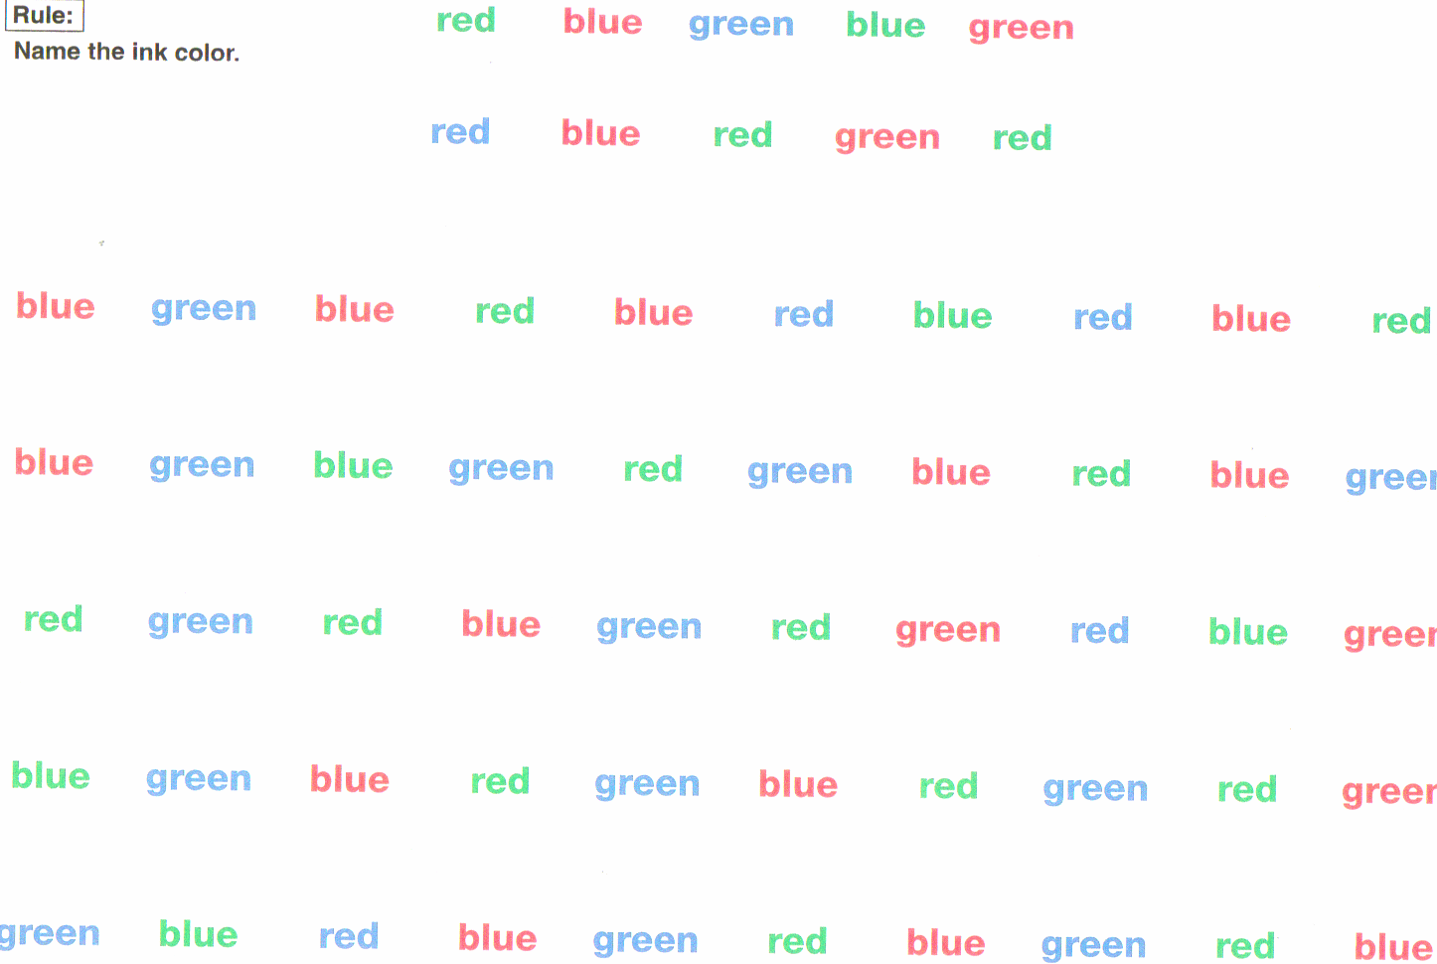
D-KEFS Color-Word Interference Subtest

Slide 96
EF Assessment
Direct Formal:
Standardized Norm-referenced Tests
D-KEFS, WCST, NEPSY-II
Cross-battery Cascading Production Decrement /Increment Analyses

Slide 97
Key Concept
Assessment of Executive Functions does not occur “in a vacuum.” In order to evaluate how EFs cue and direct, they must have something (i.e., specific perceptions, emotions, thoughts, or actions) to cue and direct.

Slide 98
Individually-administered Assessments of EF
Executive Functions must be assessed in tandem with other mental constructs.
Specific measures of Executive Functions always involve the assessment, to some degree, of a construct other than executive functions.
For the most accurate observation or measurement of EFs, the contributions of other constructs need to be minimized, controlled for, or acknowledged.

Slide 99
Key Concept
EFs in the Symbol System arena are best assessed by using methods that can reveal Cascading Production Decrements or Cascading Production Increments

Slide 100
Cascading Production Decrement
Construct
Start here
Construct + EF
Construct + + EF
Progressive deterioration
of performance is observed
as executive function demands (+ EF) become greater.
Construct+ + + EF

Slide 101
Individually-administered Assessments of EF
Identify a specific cognitive construct baseline using a measure that minimizes EF involvement.
Select and use a measure that adds executive function demands to the baseline construct and observe the results.
Continue to add additional EF demands and observe results.

Slide 102
Increment Production Cascading
Construct
Construct
+ EF
Cascading production increment: Progressive improvement
of performance is observed
as task embedded executive function demands (+ EF)
are lessened.
Construct
+ + EF
Construct
+ + + EF
Start here

Slide 103
Cascading Production Decrement
Reasoning Ability:
Matrix Reasoning
Start here
Reasoning
Ability
+ + + EF:
WCST
Progressive deterioration
of performance is observed
as executive function demands (+ EF) become greater.

Slide 104
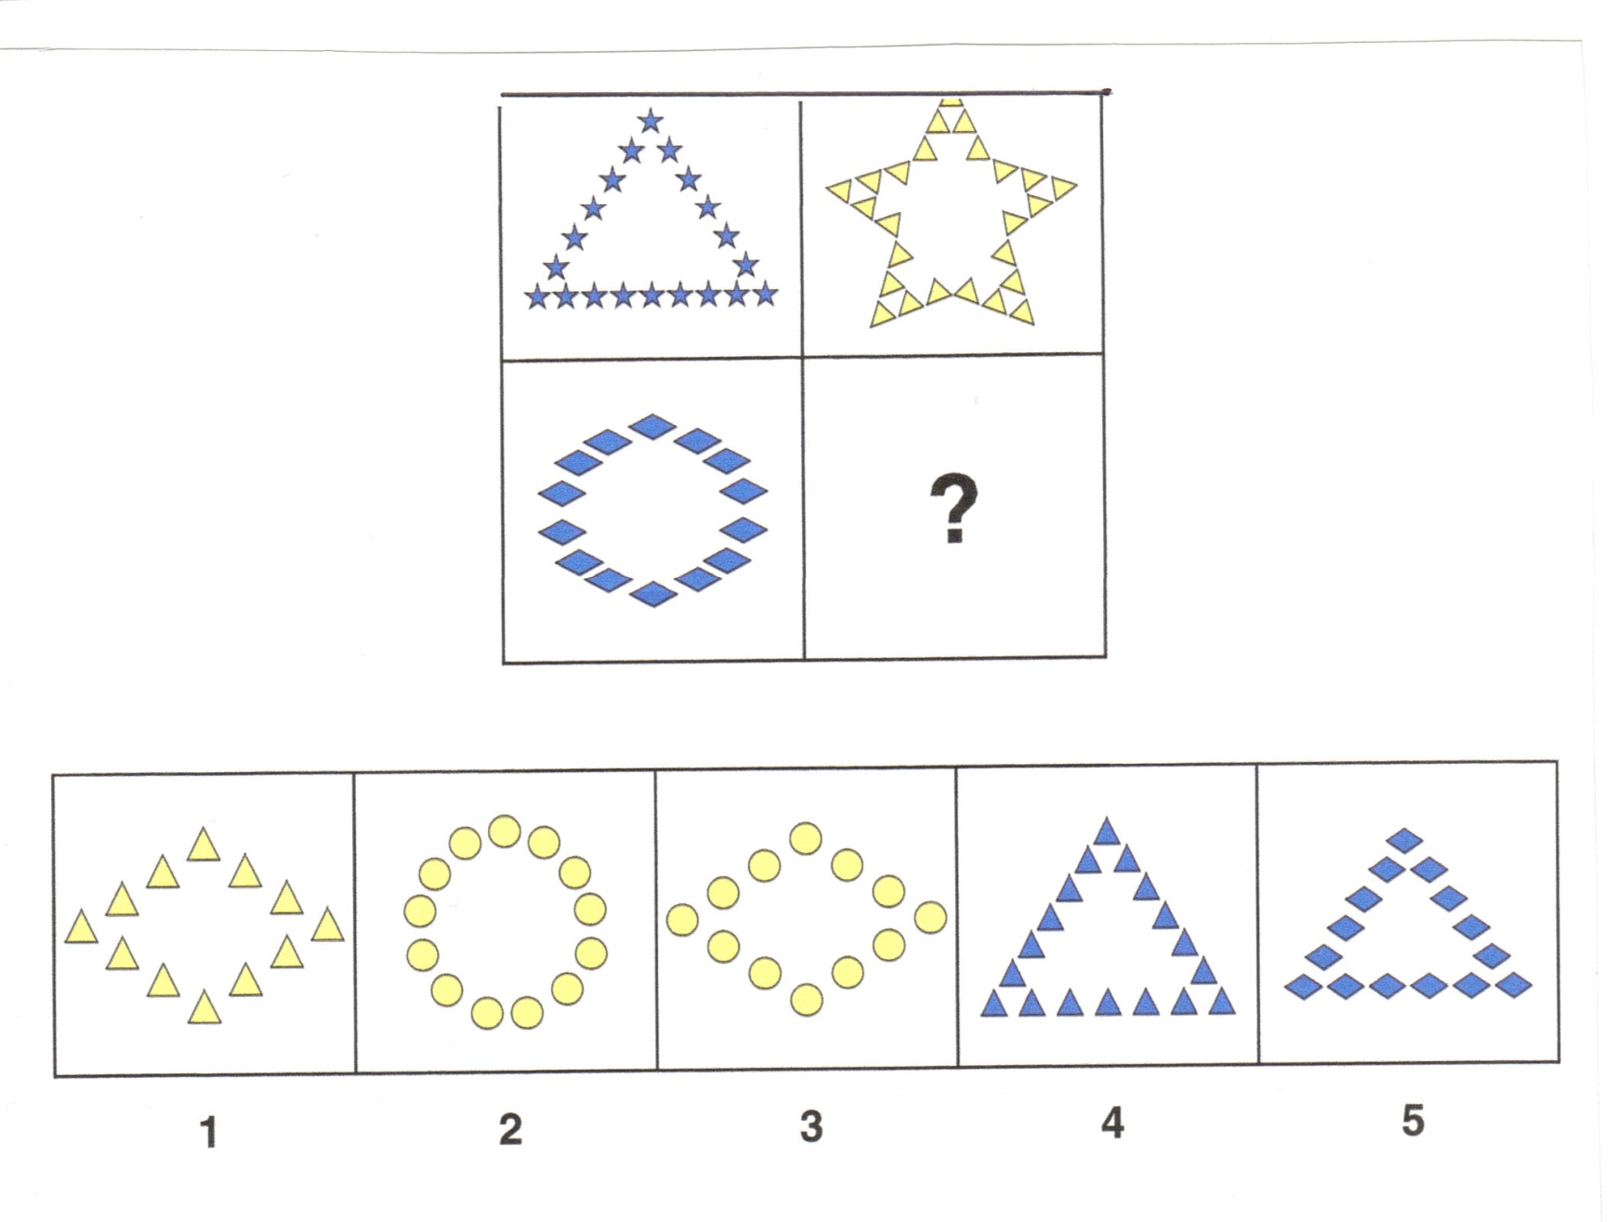
Measuring intelligence with a reasoning task

Slide 106
Cascading Production Decrement
Visuo-motorAbility:
Design Copying
Ability + EF:
BVMGT
Start here
Ability + + EF
Ability + + + EF:
RCFT
Progressive deterioration
of performance is observed
as executive function demands (+ EF) become greater.

Slide 107
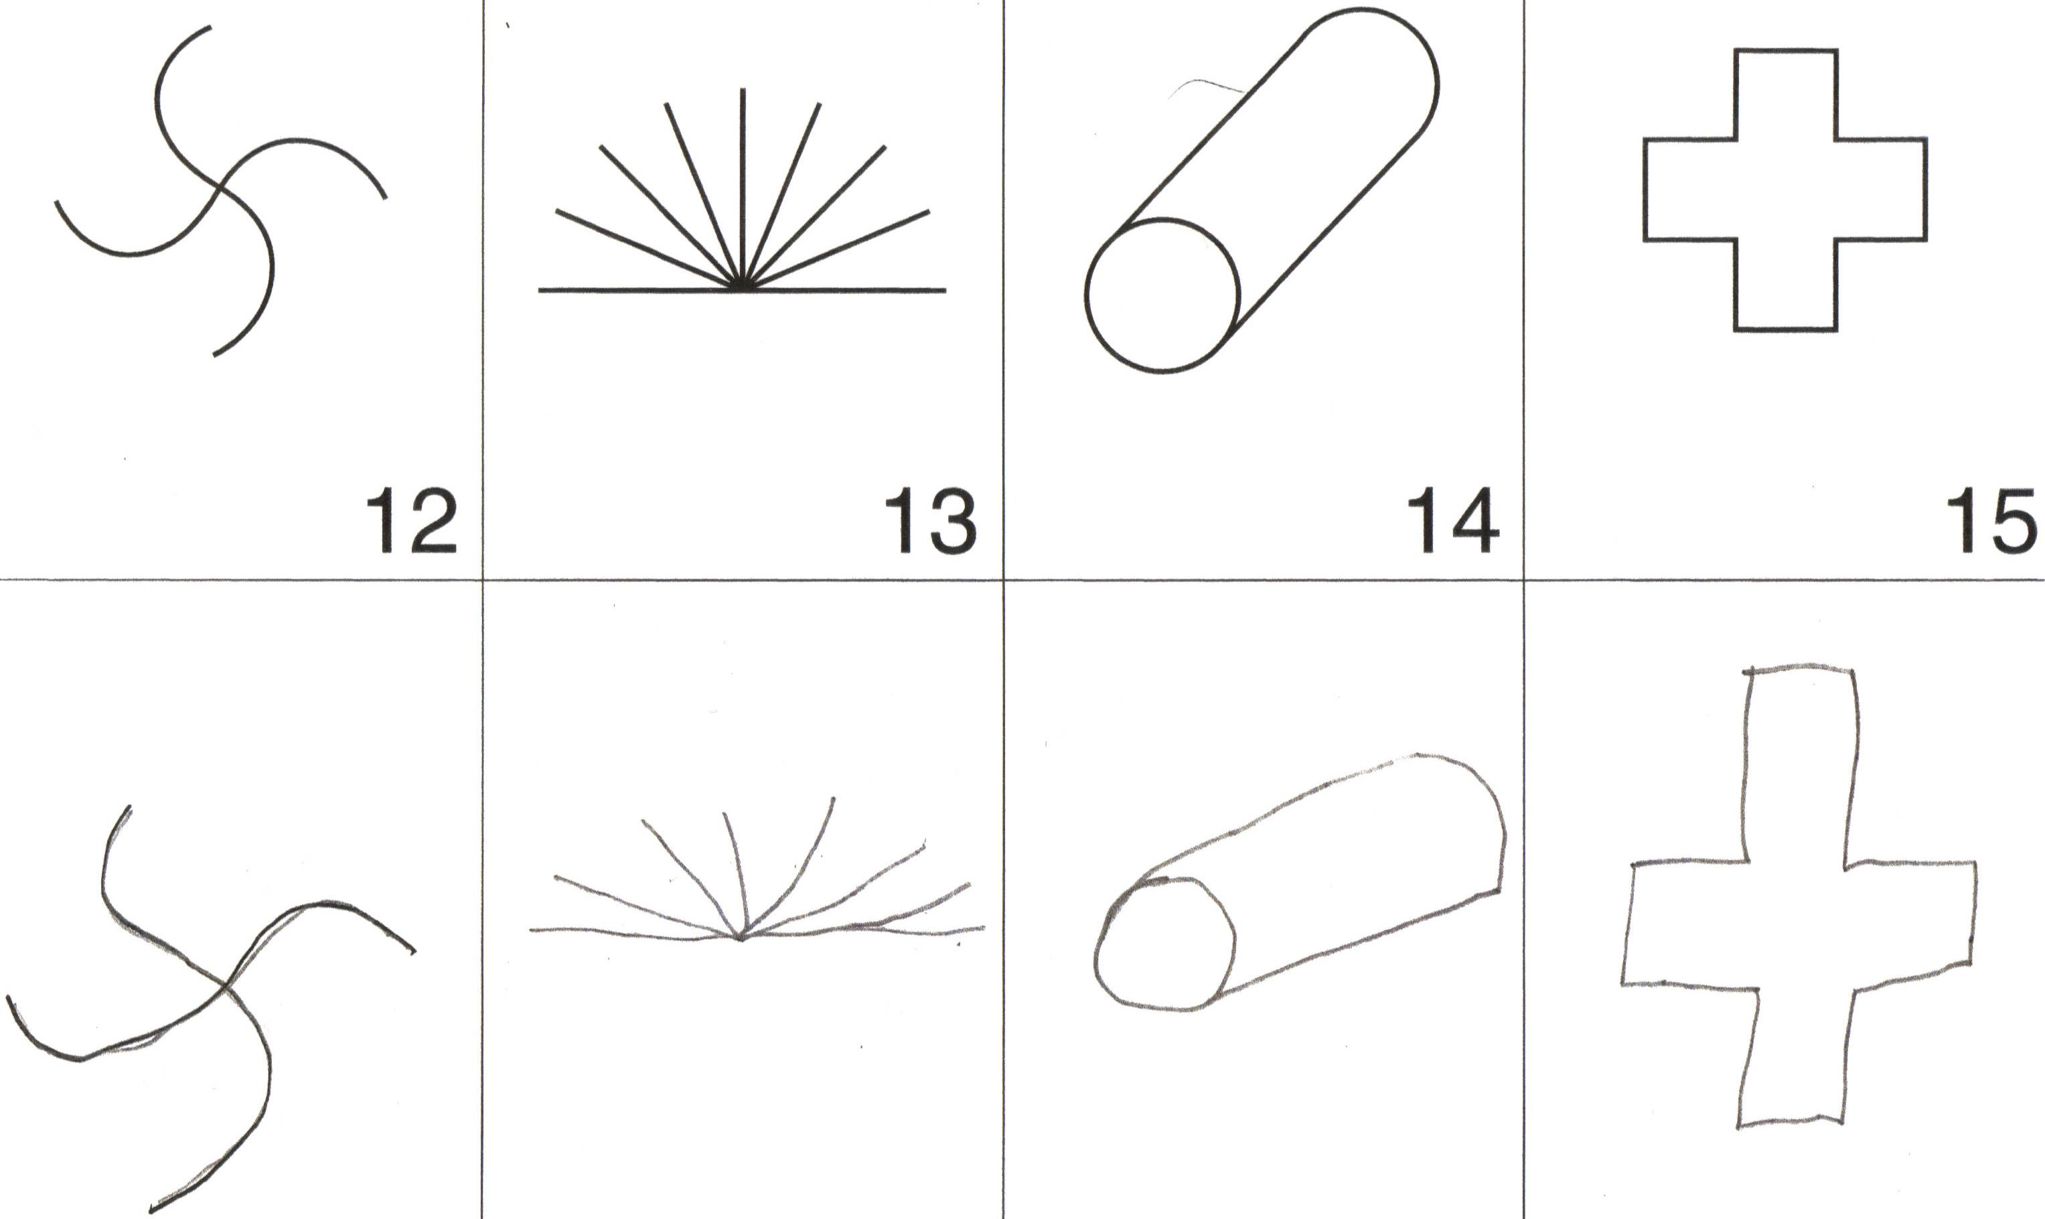
James Age 10, NEPSY Design Copying:
Scaled Score 12, 75th percentile

Slide 108
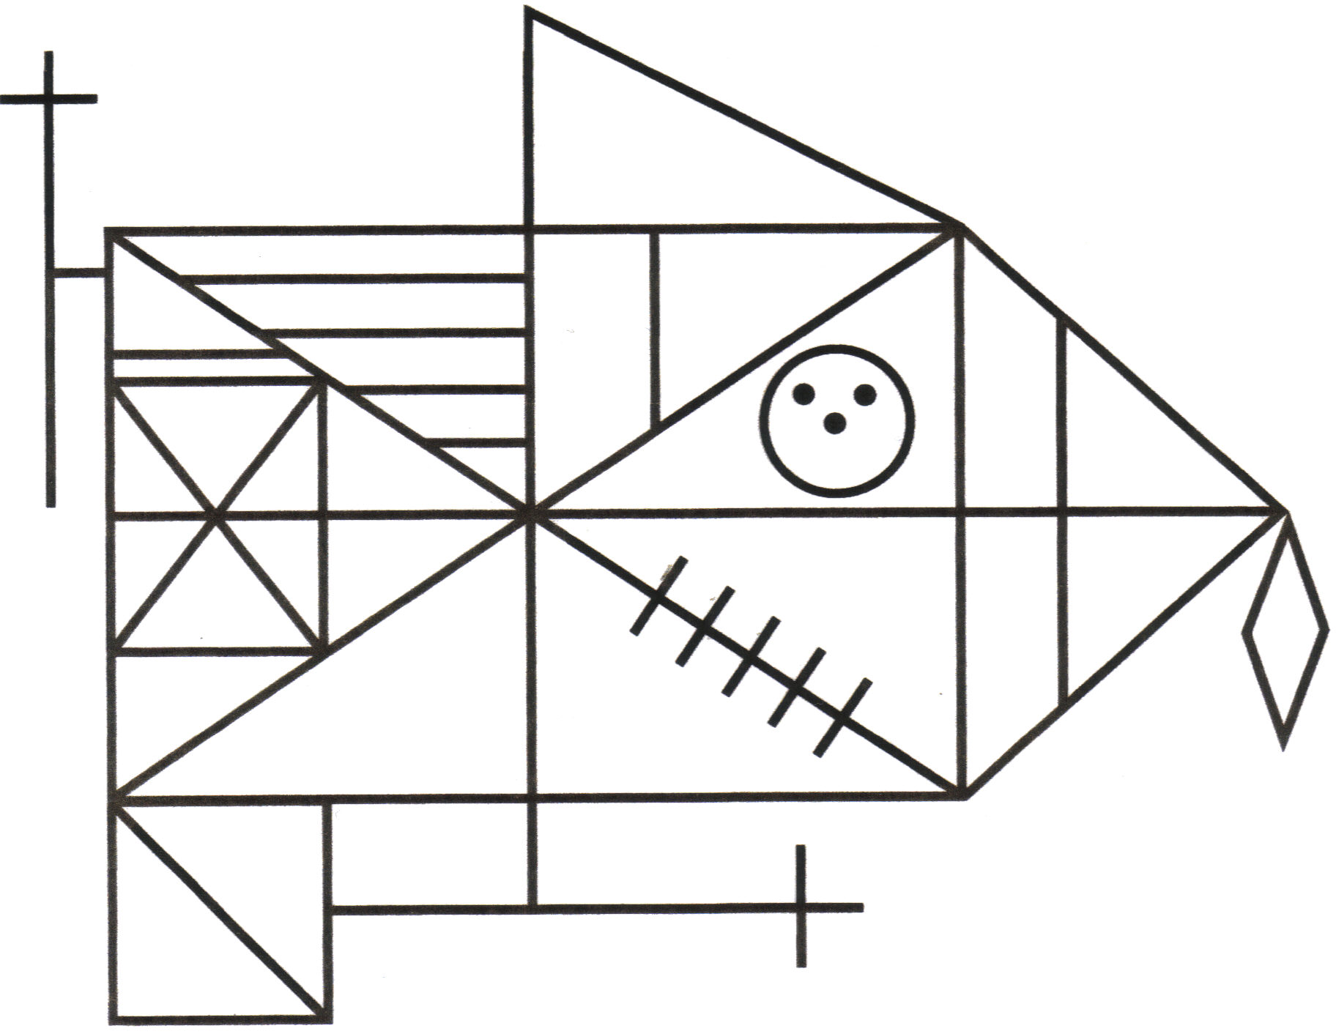
Now draw this:

Slide 109
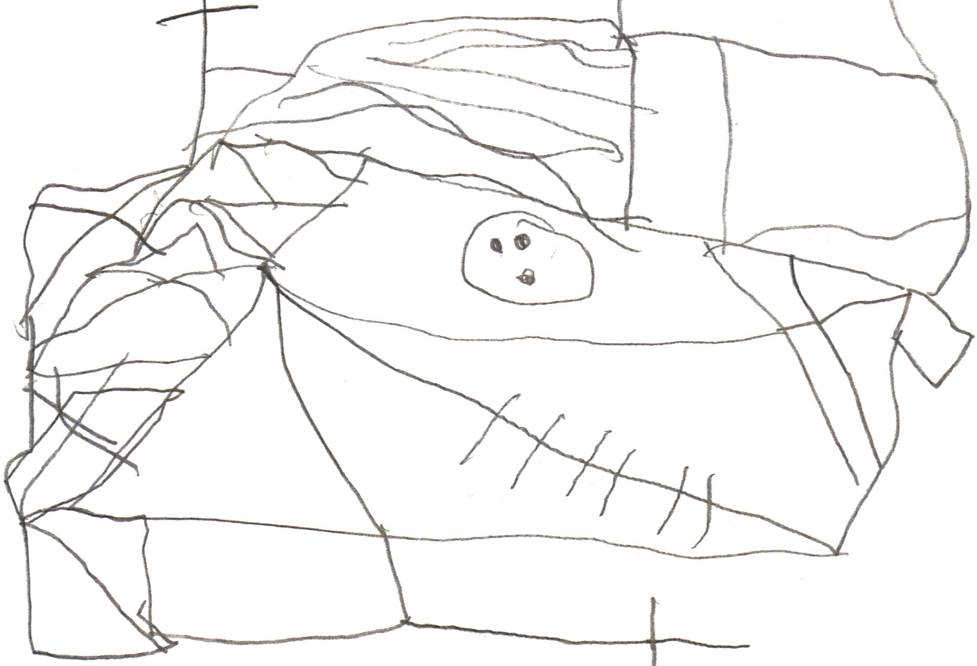
James Age 10,
Rey Complex Figure Copy:

Slide 110
Assessing Retrieval Fluency
Examples:
Naming animals in 60 seconds
Naming foods in 60 seconds
Naming words that begin with the letter “s” in 60 seconds
Naming words that begin with the letter “f” in 60 seconds

Slide 111
Assessing Retrieval Fluency
Examples of response patterns:
Semantic “Flooding” – Retrieval with minimal executive direction; uncontrolled flow of words
Controlled Access – Executive Functions used to organize retrieval of words by semantic clusters

Slide 112
Assessing Retrieval Fluency
Examples of response patterns:
Semantic “Flooding” results in uneven performance across a 60 second interval with decreased production in each successive 15 second interval.

Slide 113
Assessing Retrieval Fluency
1” – 15”
Largest number of responses
15 responses
16” – 30”
Reduced number of responses
4 responses
31” – 45”
Reduced number of responses
1 response
46” – 60”
Few, if any, responses
0 responses

Slide 114
Assessing Retrieval Fluency
Examples of response patterns:
Controlled Access typically results in a more even distribution of responses across a 60 second interval. Responses are often reflect organized, sequential access of various subcategories (e.g., water animals; flying animals; farm animals; forest animals; jungle animals;

Slide 115
Assessing Retrieval Fluency
1” – 15”
6 responses
Similar numbers
of responses for
each interval
16” – 30”
6 responses
31” – 45”
5 responses
46” – 60”
5 responses

Slide 116
Cascading Production Decrement
Start here
Retrieval Ability:
Semantic Fluency
Retrieval
Ability + EF:
Initial Letter Fluency
Progressive deterioration
of performance is observed
as executive function demands (+ EF) become greater.

Slide 117
Key Concept
Executive Functions are inextricably interwoven with all forms of academic production.

Slide 118
Executive Functions and Reading
Executive Functions are inextricably interwoven into the act of reading.

Slide 119
An Integrative Model Specifying Processes, Abilities, Lexicons, Skills, Memory and Achievement in Reading
indicate
Executive
Function
processing
at work
General & Specific
Knowledge Lexicons
Semantic Lexicon
Word & Phrase Knowledge
Language
Reasoning
Visuospatial
Initial
Registration
(Immediate
Memory)
Comprehending Words and Text
Speed
Decoding
Unfamiliar
and/or
Nonsense
Words
+ Prosody =
Reading Rate
aka
“Fluency”
Reading
Familiar
(Sight)
Words
Working
Memory
Retrieval
from Long
Term Storage
Phonological Processing
Oral Motor Processing
Orthographic Processing

Slide 120
Assessing Executive Functions Related to Reading
Example of D-KEFS Color-Word Interference Word Reading task:
“Look at this page…read these words as quickly as you can without making any mistakes.”

Slide 121
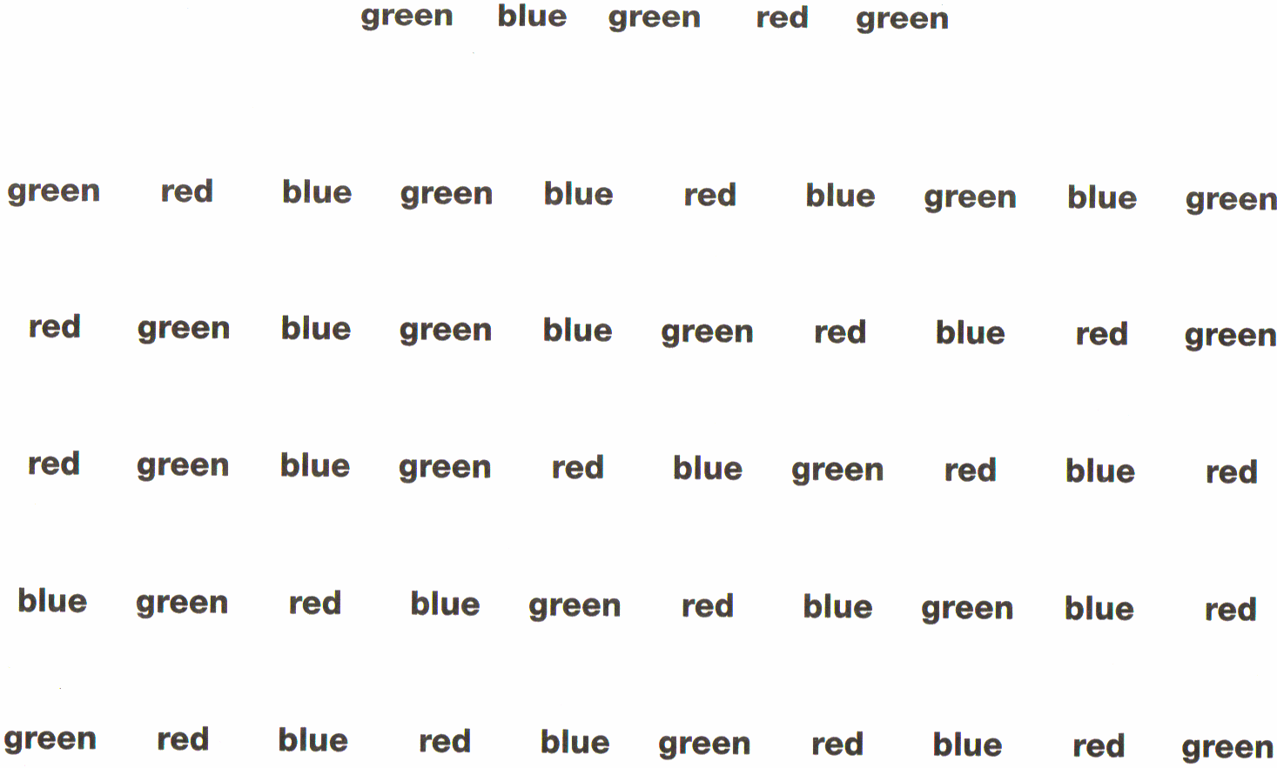

Slide 122
Assessing Executive Functions Related to Reading
Example of D-KEFS Color-Word Interference Inhibition task:
“Look at this page…the color names are printed in a different colored ink. You are to name the color of the ink that the letters are printed in not read the word.”

Slide 124
Assessing Executive Functions Related to Reading
Example of D-KEFS Color-Word Interference Inhibition-Switching task:
“This time, for many of the words you are to name the color of the ink and not read the words. But if a word is inside a little box, you should read the word and not name the ink color.”

Slide 125
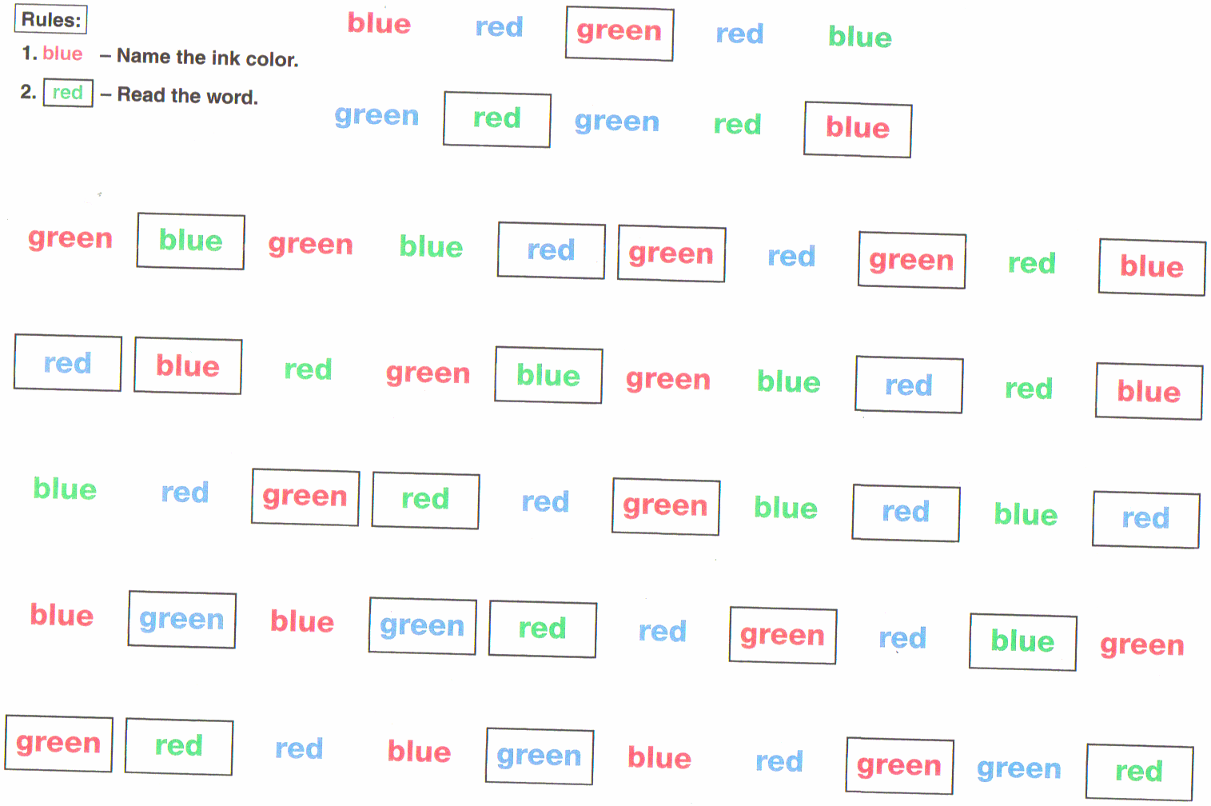

Slide 127
Cascading Production Decrement
Process:
D-KEFS
Color &
Word Naming
Process + EF:
D-KEFS CWI
Inhibition
Progressive
deterioration
of performance is observed
as executive function demands (+ EF) become greater.
Process + + EF:
D-KEFS Inhibition/
Switching

Slide 128
EF Assessment
Direct Informal:
Process-oriented interpretation of assessment performance
Child Interview
Behavior Observations

Slide 129
Interpretive Levels Framework
Global Composite
Full Scale IQ Level
GAI &
Specific Composite Indexes / Clinical Clusters Level
Subtest Level
Item Level
Cognitive
Constructs
Level

Slide 130
Interpretive Levels
The Process Approach requires a clear understanding of what a task measures so that performance can be effectively task analyzed to characterize a person’s cognitive capacities as accurately as possible.
Notes:
SI- changed scoring to 2,1,0 on initial items b/c got better discrimination between mild and mod disabilities

Slide 131
Behavior Observation and Inferences about Brain Function
What’s the difference between a Similarities Scaled Score of 12 (75th percentile) …
…and a Similarities Scaled Score of 12 (75th percentile)?

Slide 132
Subtest/Item Level Interpretation Process Approach Example
Retrieval of verbal information from long-term storage
vs
Reasoning with verbal information

Slide 133
Subtest/Item Level Interpretation Process Approach Example
Performance on Similarities also may or may not involve the engagement of one or more executive functions (e.g., gauge, flexible, shift, associate).

Slide 134
Executive Functions and Academic Production
In the classroom, the task most frequently impacted by executive function-driven producing difficulties is written expression.

Slide 135
An Integrative Model Specifying Processes, Abilities,
Lexicons, Skills, Memory and Achievement in Writing
indicate
Executive
Function
processing
at work
General & Specific
Knowledge Lexicons
Semantic Lexicon
Word & Phrase Knowledge
Language
Idea Generation
Reasoning
Visuospatial
Initial
Registration
(Immediate
Memory)
Text Editing & Revising
Text
Production
Automaticity
Text
Transcription
&
Spelling
Text
Generation
Working
Memory
Retrieval
from Long
Term Storage
Visuospatial Processing
GraphoMotor Processing
Orthographic Processing
Phonological Processing

Slide 136
Writing as a Holarchically Organized Process
PLAN
PLAN
ORGANIZE
Reviewing/Revising
Text Generation
Text Transcription
Language Representation
Idea Generation

Slide 137
Executive Functions and Writing
What Evan wrote for me:
My favorite game is … “mabul
roling it is
fun. I like making
the box to role in
to. Iam prety gode as
well. It is rell inters
ing. It is so fun

Slide 138
Executive Functions and Writing
What Evan told me:
“My favorite game is rolling marbles. I think it is fun. I just learned it yesterday. It can be pretty hard at times. It can be fun and it’s interesting if you make it challenging. I like making the boxes to roll the marbles into. You probably need to be pretty skilled with eye hand coordination to do it. To get up the ramp you need to roll it really fast.”

Slide 139
James Age 10, NEPSY Design Copying:
Scaled Score 12, 75th percentile

Slide 140
Now draw this:

Slide 141
James Age 10,
Rey Complex Figure Copy:

Slide 142
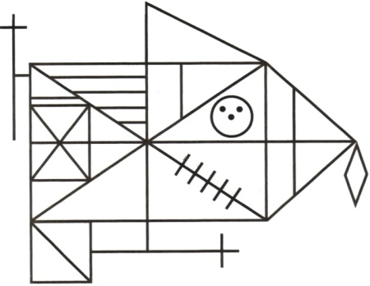
James Age 10, Rey Complex Figure Recall after 3 minutes:

Slide 143
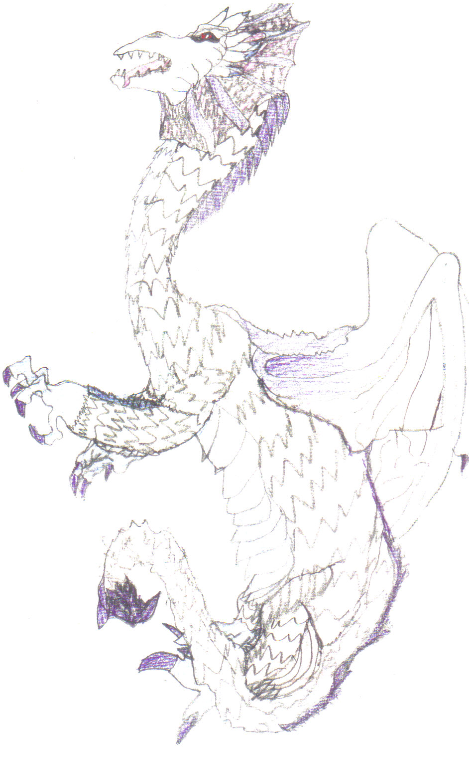
James Age 10,
Self-generated
freehand drawing

Slide 144
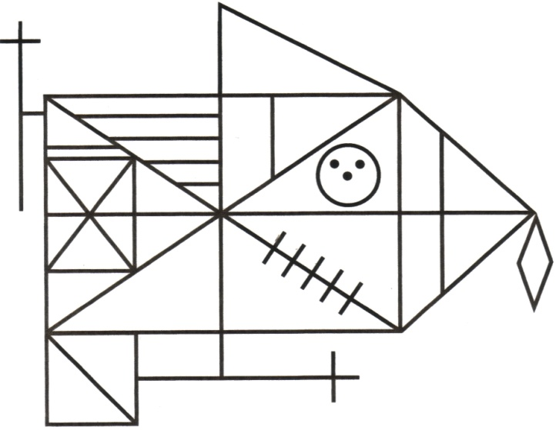
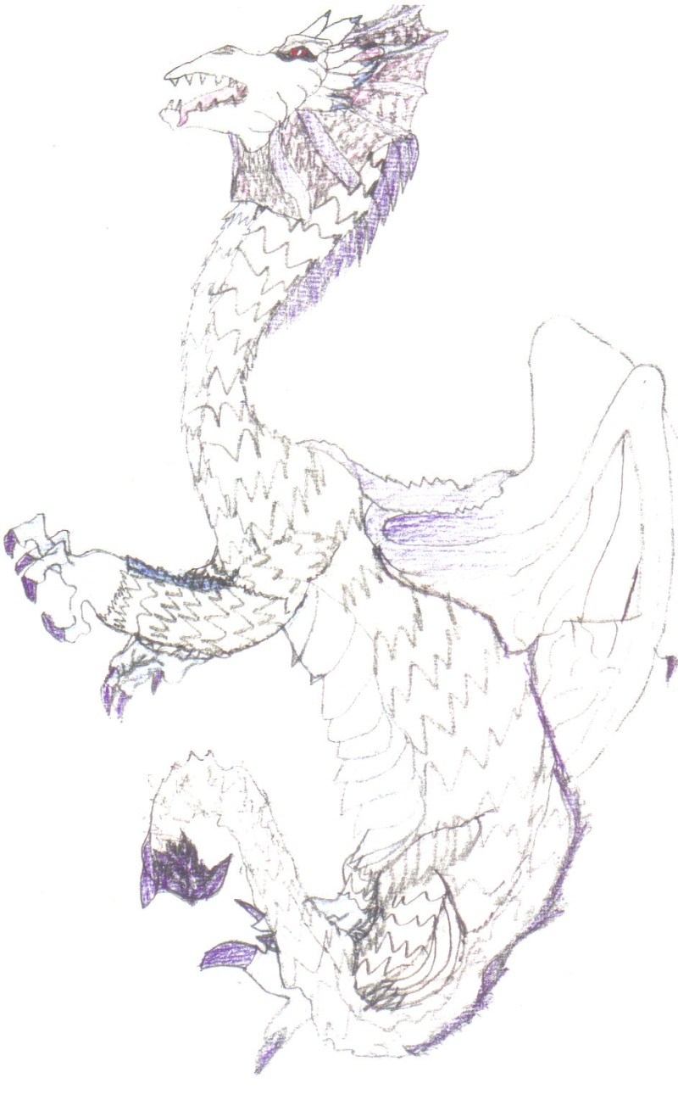
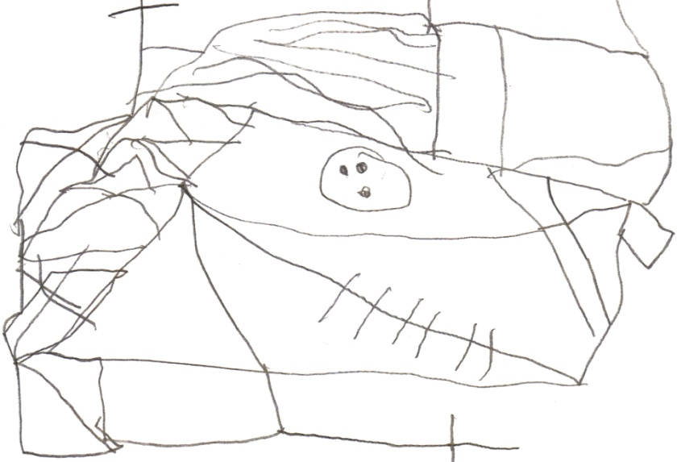
Production based on External Demand:
Production based on
Internal Command:

Slide 145
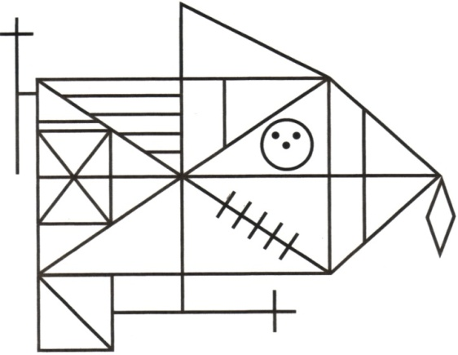
James Age 10, Rey Complex Figure Copy Verbally Mediated by Psychologist:

Slide 146
James Age 10, Rey Complex Figure Copy:
Self-initiated
Verbally Mediated

Slide 147
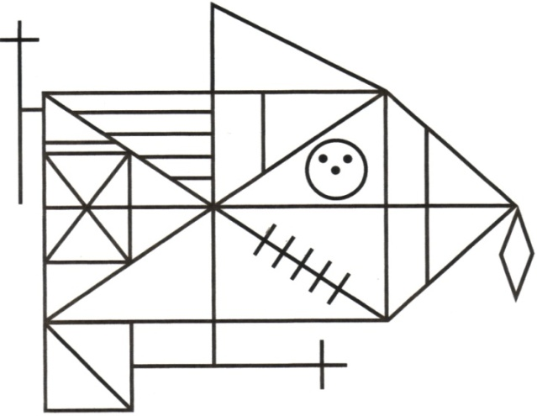
James Age 10, Rey Complex Figure Copy:
On-Demand Self-Completed
2 ½ Hours Later

Slide 148
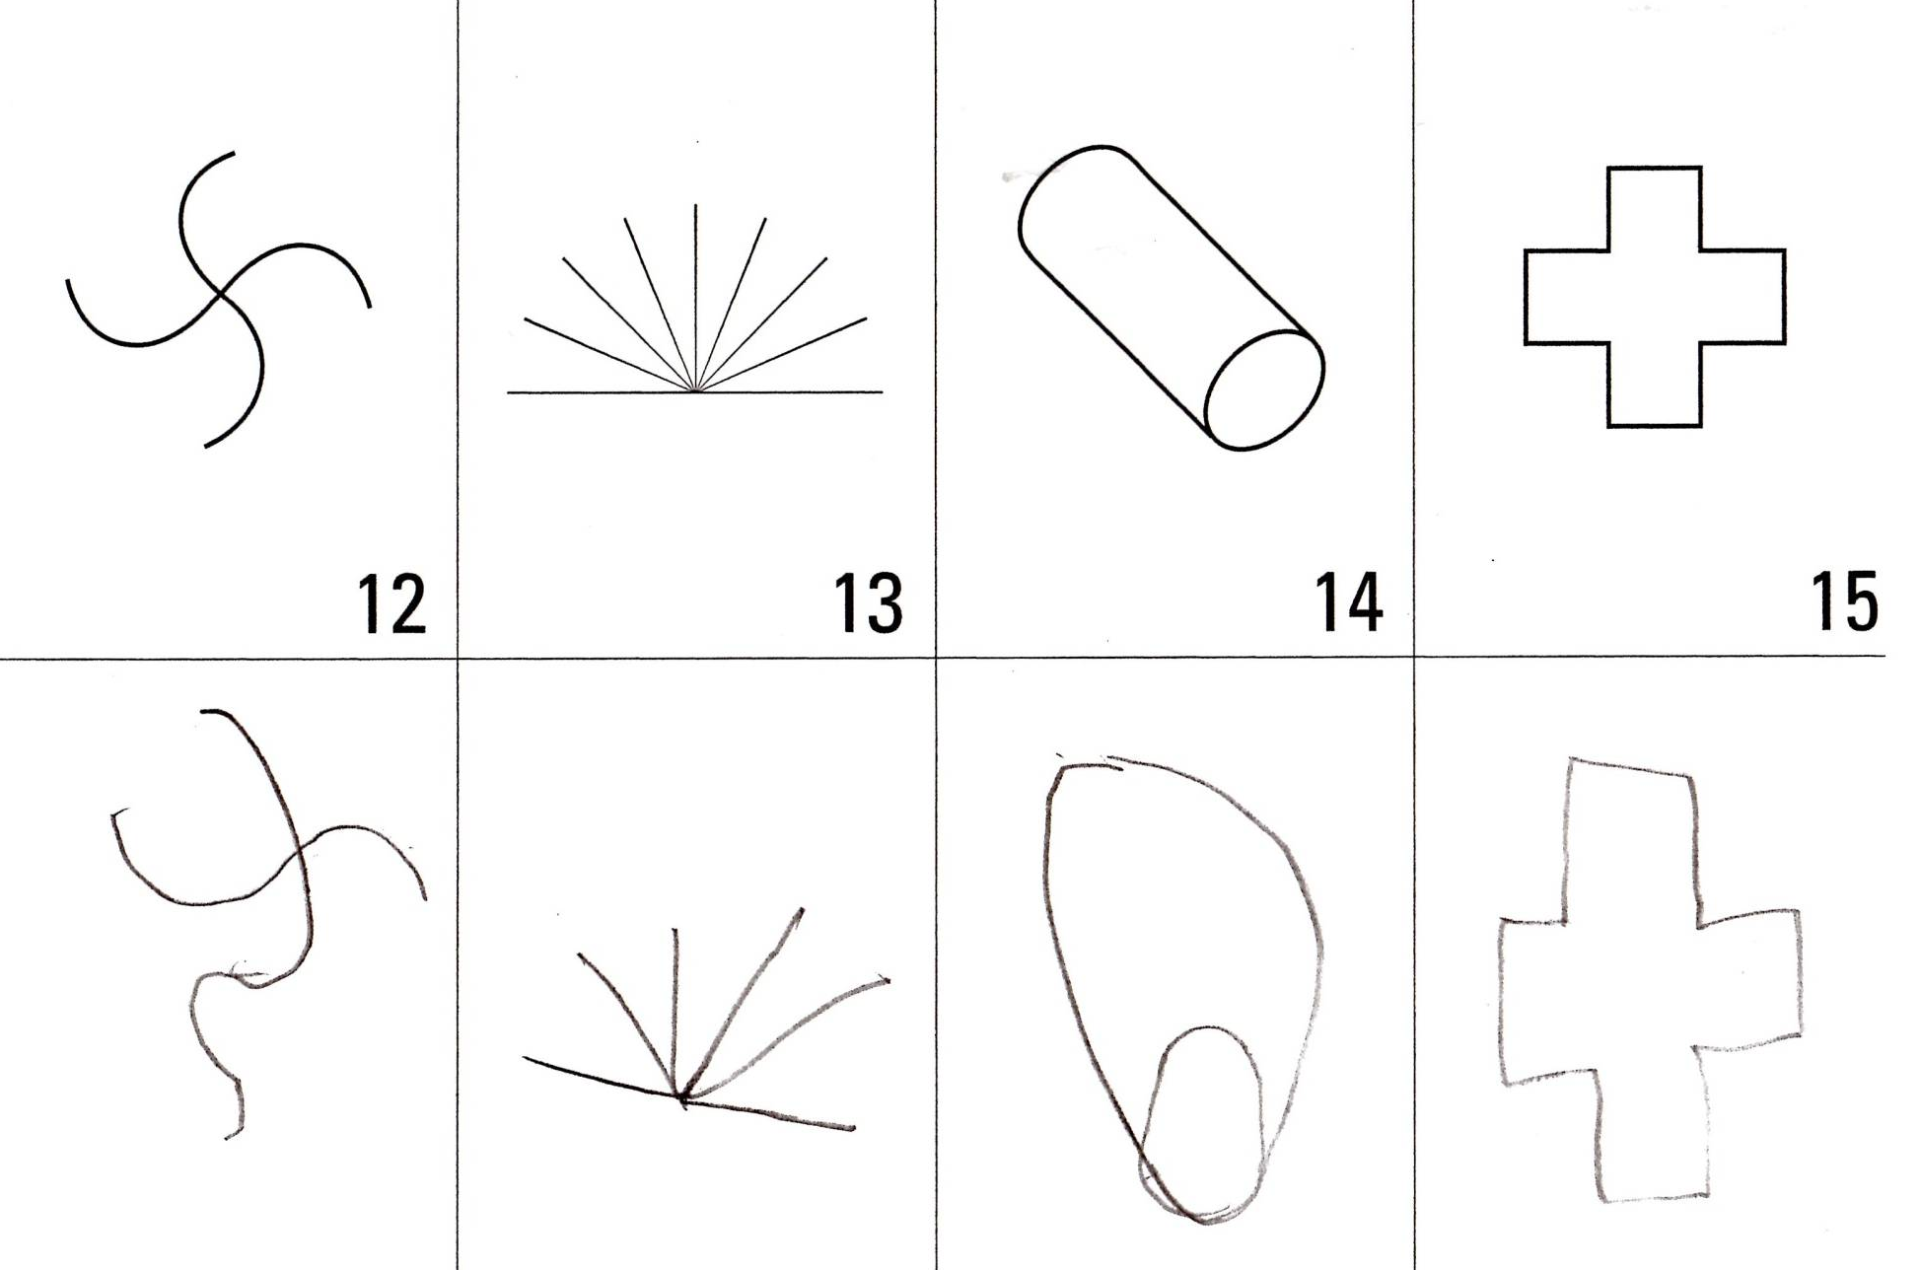
Martin Age 9, NEPSY Design Copying:

Slide 149
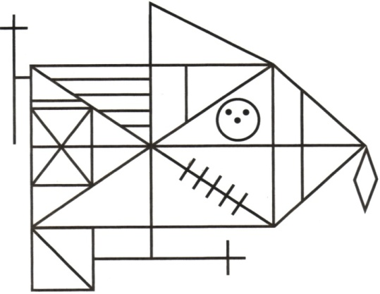
Martin Age 9, Rey Complex Figure Copy:

Slide 150
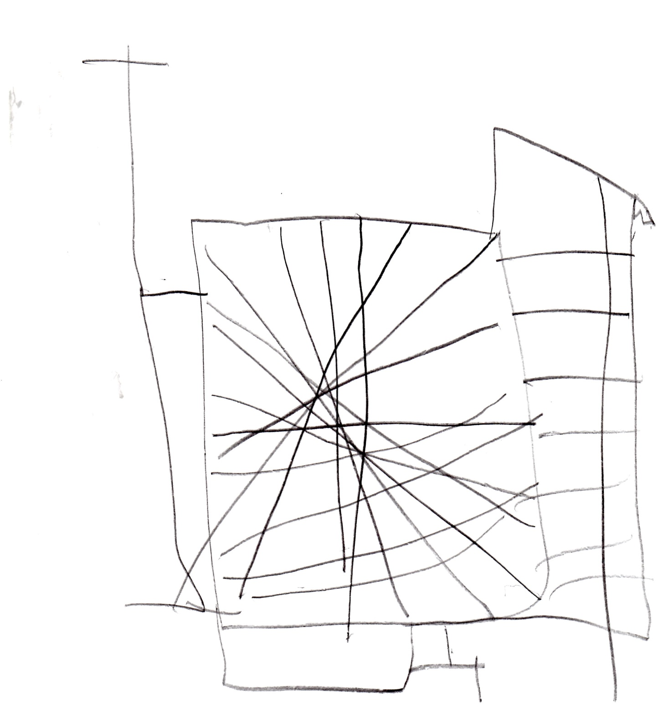
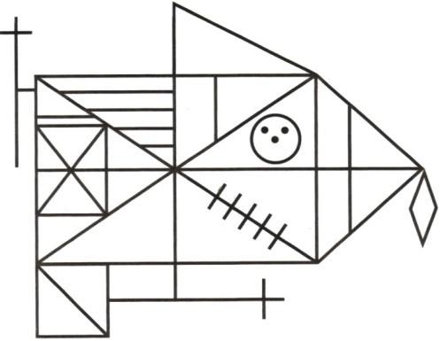
Martin Age 9,
Rey Complex
Figure Copy
Verbally
Mediated by
Psychologist:

Slide 151
Alphabet Writing Nov 2010

Slide 152
WJ-III Writing Fluency Nov 2010

Slide 153
Martin Age 9,
Rey Complex
Figure Copy
Self-generated
5 months later:

Slide 154
Martin Age 9,
Rey Complex
Figure Copy
Self-generated
8 months later:

Slide 155
Martin Age 9,
Rey Complex
Figure Copy
Verbally
Mediated
8 months later:

Slide 156
Martin Age 9, Rey Complex Figure Copy:
Self-initiated
Nov, 2010
Verbally Mediated
August, 2011

Slide 157
Martin’s WISC Score Changes
11/2010
4/2013
9/2015
FSIQ | 70 | 99 | 103
GAI | 83 | 105 | 108
VCI | 73 | 95 | 106
PRI/FRI | 94 | 117 | 112
VSI | -- | -- | 111
WMI/AWMI | 62 | 97 | 94
PSI | 68 | 85 | 98

Slide 158
Martin’s Achievement Score Changes
11/2010
4/2013
9/2015
Wd Reading | 71 | 94 | 98
Wd Decoding | 81 | 97 | 98
Rdg Fluency | 66 | 95 | 100
Rdg Comp | -- | 87 | 82
Rdg Vocab | -- | 93 | 112

Slide 159
Alphabet Writing Nov 2010

Slide 160
Alphabet Writing August 2012

Slide 161
WJ-III Writing Fluency Nov 2010

Slide 162
WJ-III Writing Fluency Aug 2012

Slide 163
WJ-III Writing Fluency Aug 2012

Slide 164
WJ-III Writing Fluency Aug 2012

Slide 165
Martin Age 14,
Rey Complex
Figure Copy
Unassisted
September
2016:

Slide 166
EF Assessment
Direct Informal:
Process-oriented interpretation of assessment performance
Child Interview
Behavior Observations

Slide 167
Child Interviews
Elements assessed through the child interview:
Self-Realization
Self-Determination
Self-Regulation
Motivation/Immediate Gratification
Sleep (habits, inertia, deprivation)

Slide 168
EF Assessment
Direct Informal:
Process-oriented interpretation of assessment performance
Child Interview
Behavior Observations

Slide 169
Behavior Observations
It is important to keep in mind that observations are completely context-dependent; generalization of inferences based on observed behaviors requires multiple observations across multiple settings.

